Slide 1
Module 13
Describing Moving Image Resources
RDA Training
University of Nevada, Reno
February 2013
Notes:
This module is intended to cover special procedures for audio recordings that differ from books. We’ve already covered thoroughly how to describe a book. We won’t go over all that again, exept to note when you do the same thing for an audio recording.

Slide 2
Please log in to RDA
http://access.rdatoolkit.org/?username=RDATraining&password=Wolfie13
Reno Workshop: Please feel free to sign up later for a month’s free access so you can practice (see handout)
Notes:
From now on, as I show slides of RDA, please feel free to go ahead and look yourself in the Toolkit.

Slide 3
Mode of Issuance
Single unit monograph?
  Single DVD
  Streaming video file
Multipart monograph?
  A film on two discs
Serial?
Integrating resource?
Notes:
This module only covers monographs.

Slide 4
Basis for Identification
RDA 2.1
Single unit monograph
  The item itself
Multipart monograph
  The first unit
Notes:
This module only covers monographs.

Slide 5
Preferred Source of Information
RDA 2.2.2.3
Choose, in the part chosen as the basis for identification, either
  the title screen(s) or frame(s)
  alternative
  a label bearing a title that is permanently printed on or affixed to the resource
  or
  embedded metadata in textual form
  If none of these is available, use
  another source forming part of the resource itself, preferring a source where the information is formally presented
Notes:
Title screen is the preferred source. Alternatively you may use a label on the disc. If the label does not include the information you need, you can go to another source forming part of the resource itself, e.g., the container.
NOTE: Title frames can come from either the beginning or the end of the resource, or both.

Slide 6

Kubrik: Preferred source
Title frames

Slide 7

Kubrik: Preferred source
Title frames

Slide 8
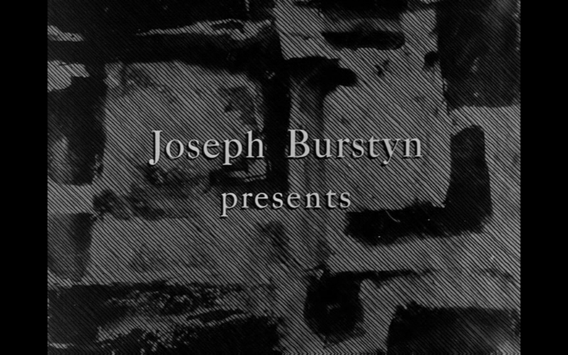
Kubrik: Preferred source
Title frames

Slide 9
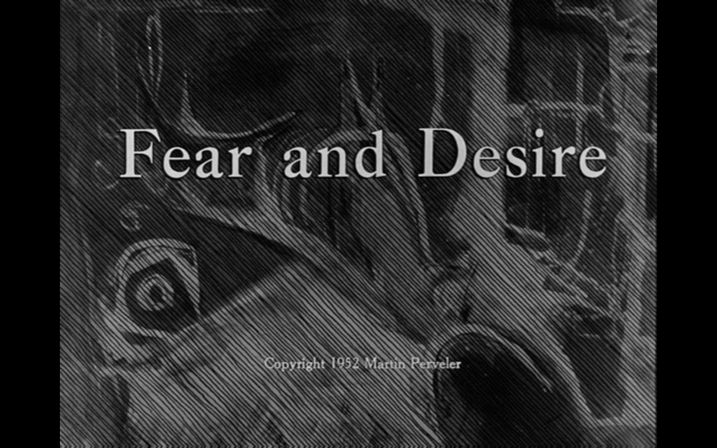
Kubrik: Preferred source
Title frames

Slide 10
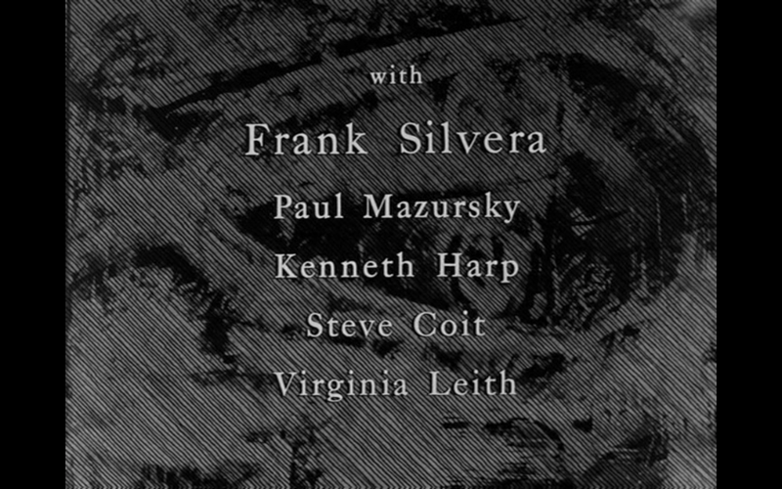
Kubrik: Preferred source
Title frames

Slide 11
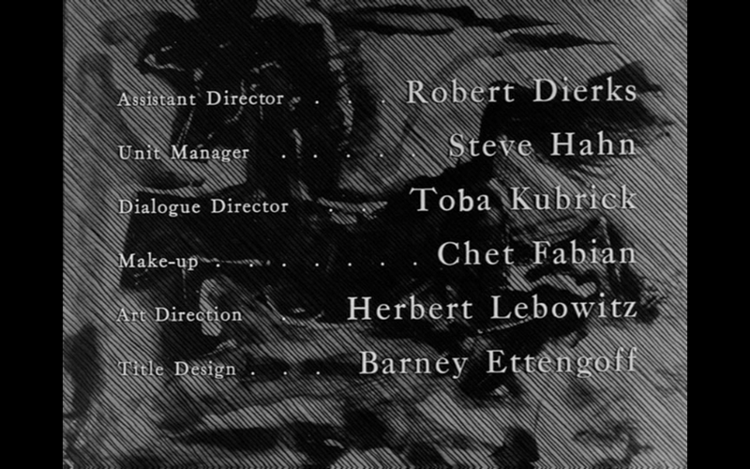
Kubrik: Preferred source
Title frames

Slide 12
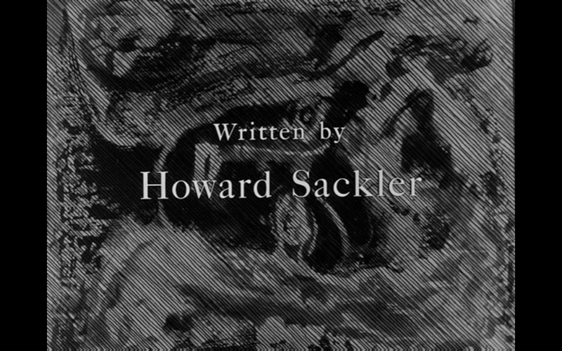
Kubrik: Preferred source
Title frames

Slide 13
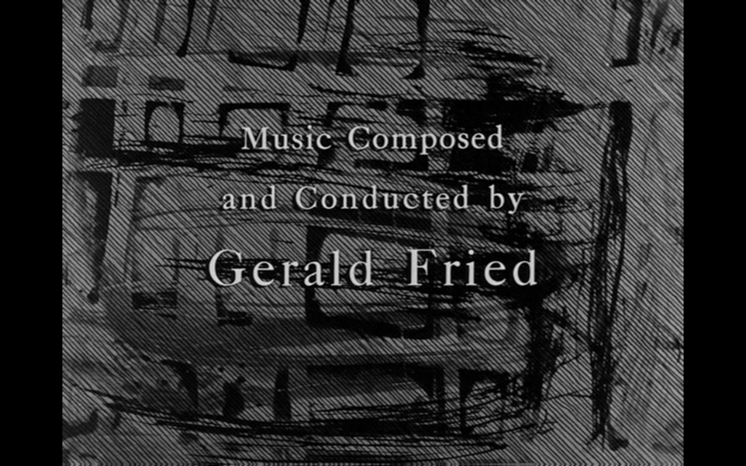
Kubrik: Preferred source
Title frames

Slide 14
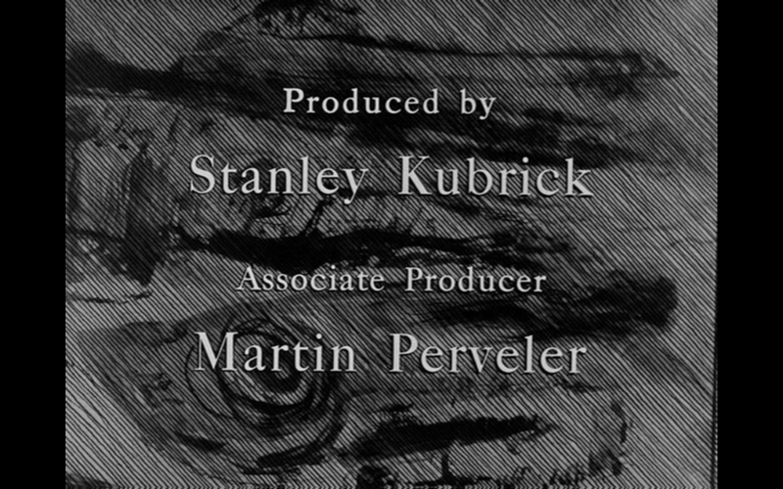
Kubrik: Preferred source
Title frames

Slide 15

Kubrik: Preferred source
Title frames

Slide 16
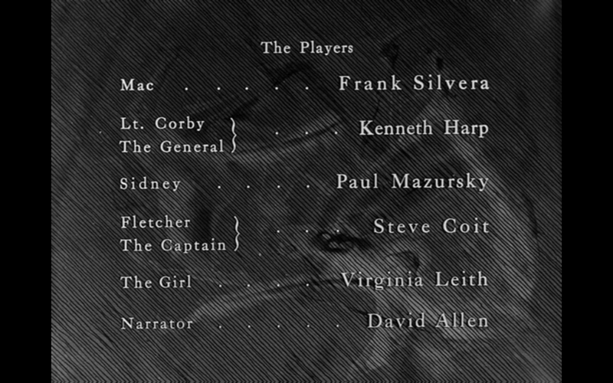
Kubrik: Preferred source
Title frames

Slide 17
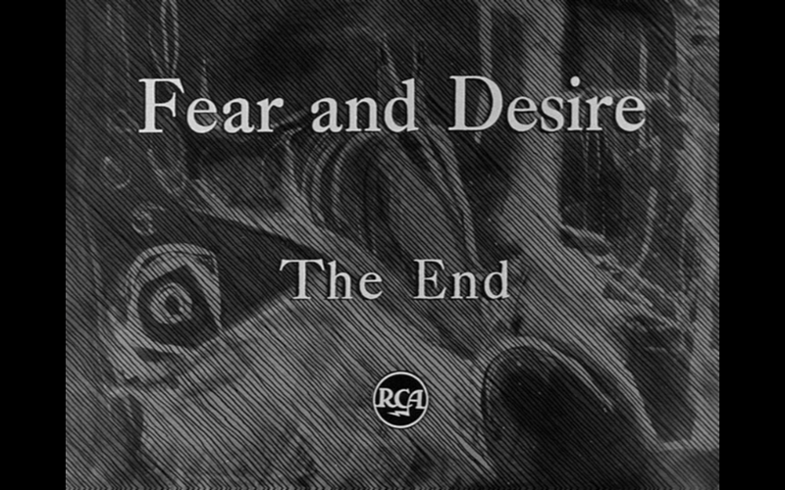
Kubrik: Preferred source
Title frames

Slide 18

Kubrik:
Alternative preferred source

Slide 19

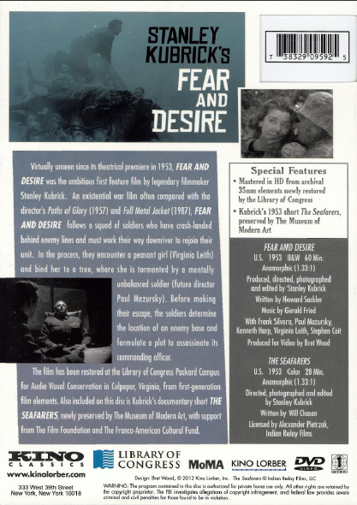
Kubrik: other source

Slide 20
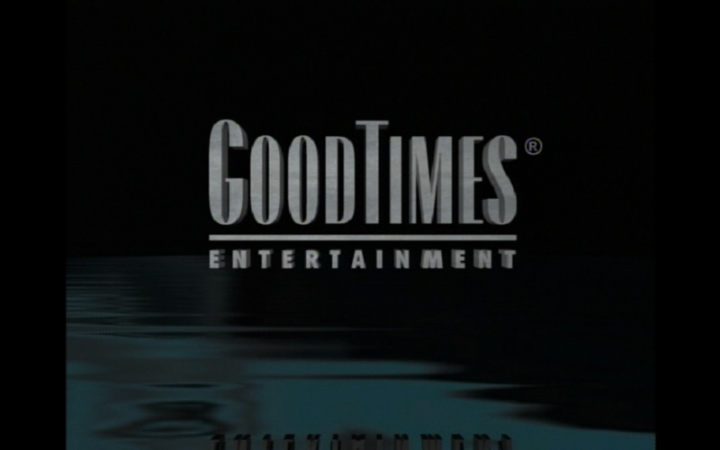
Temple: Preferred source
Title frames side 1
Notes:
Note this one is a complation, more than one film on the disc.

Slide 21
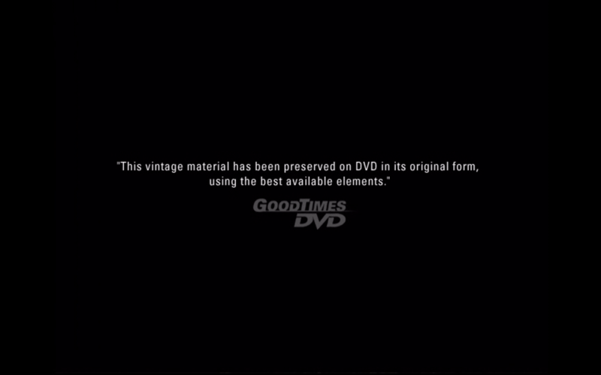
Temple: Preferred source
Title frames side 1

Slide 22
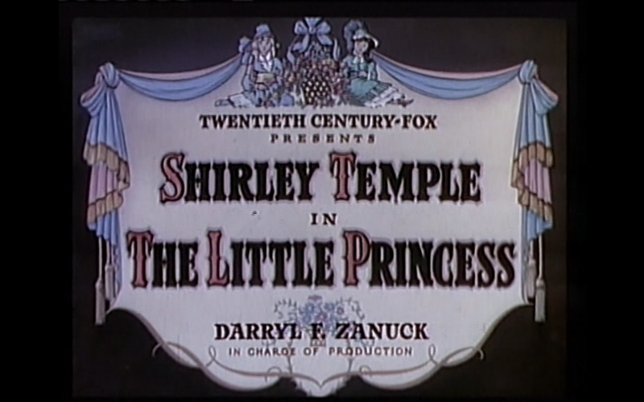
Temple: Preferred source
Title frames side 1

Slide 23
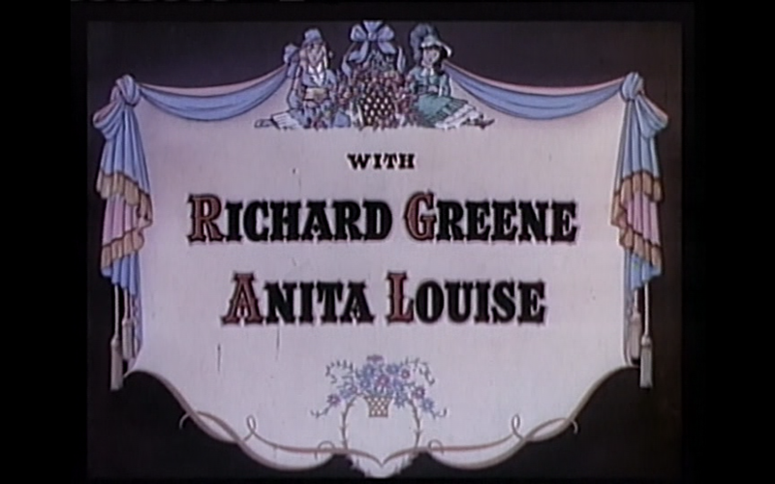
Temple: Preferred source
Title frames side 1

Slide 24
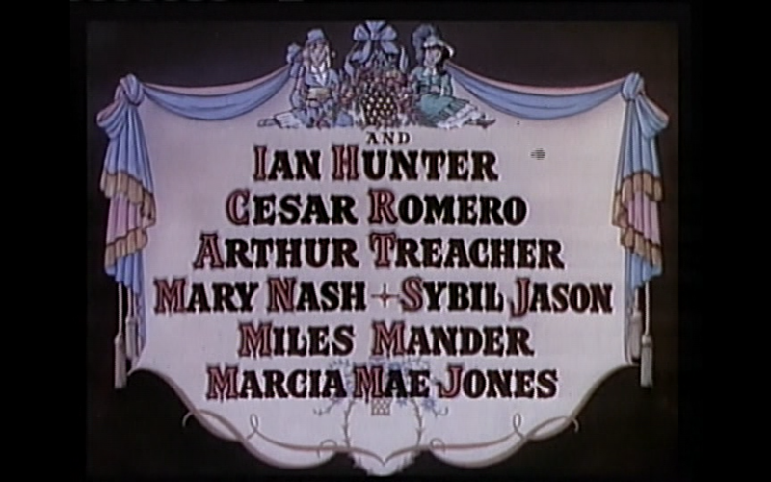
Temple: Preferred source
Title frames side 1

Slide 25
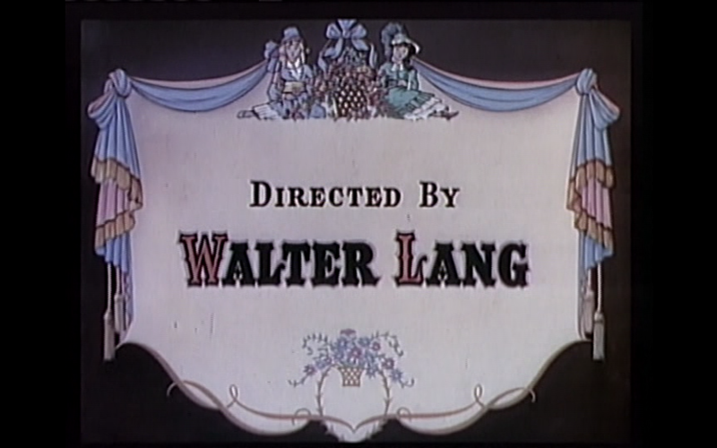
Temple: Preferred source
Title frames side 1

Slide 26
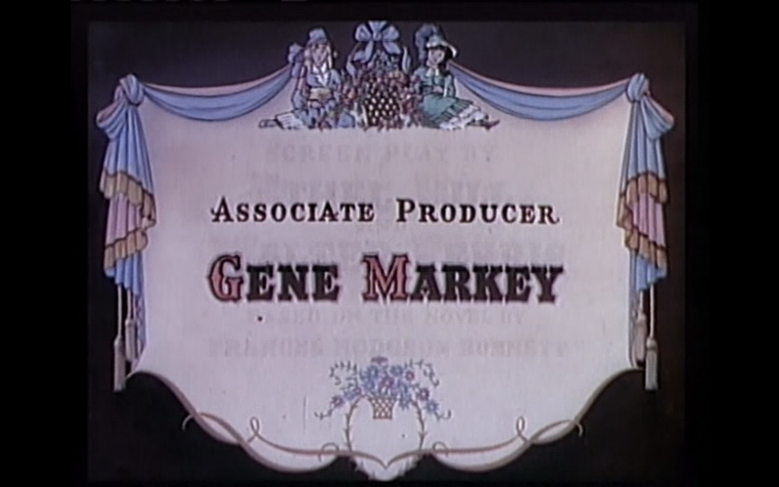
Temple: Preferred source
Title frames side 1

Slide 27
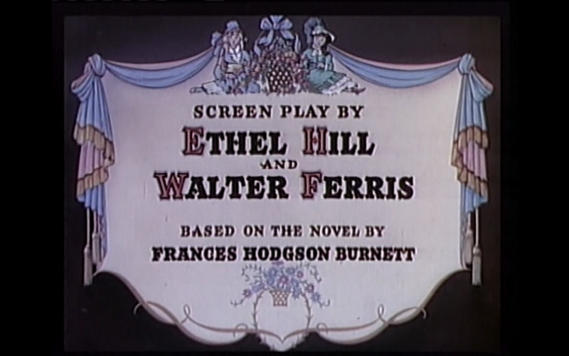
Temple: Preferred source
Title frames side 1

Slide 28
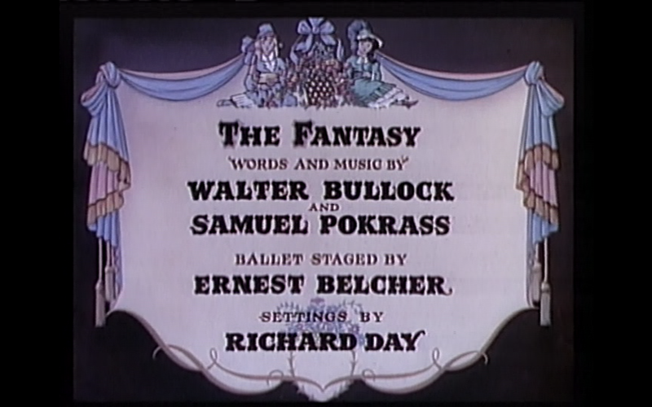
Temple: Preferred source
Title frames side 1

Slide 29
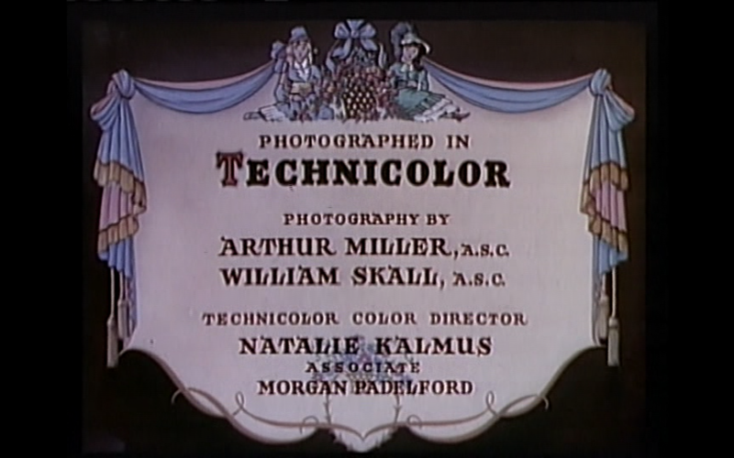
Temple: Preferred source
Title frames side 1

Slide 30
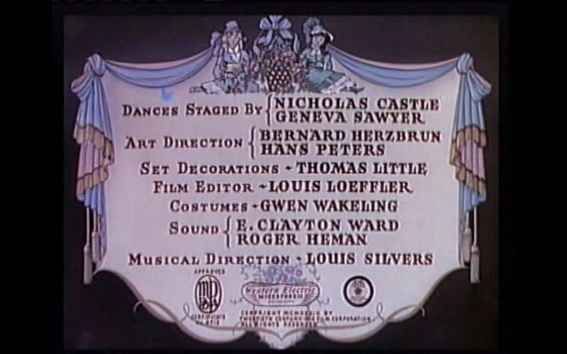
Temple: Preferred source
Title frames side 1

Slide 31
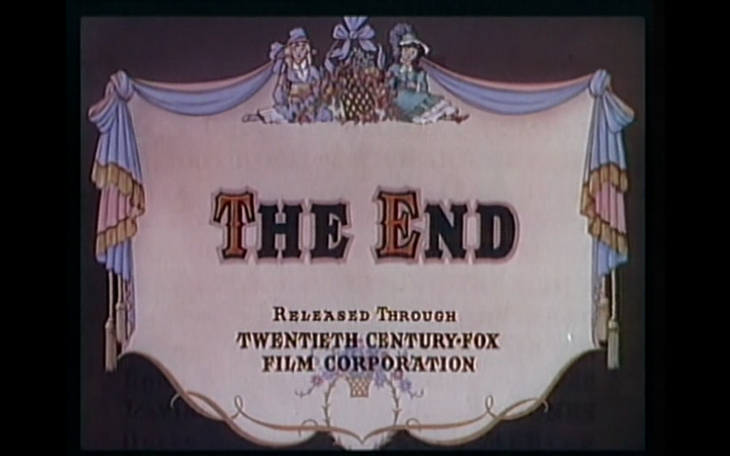
Temple: Preferred source
Title frames side 1

Slide 32
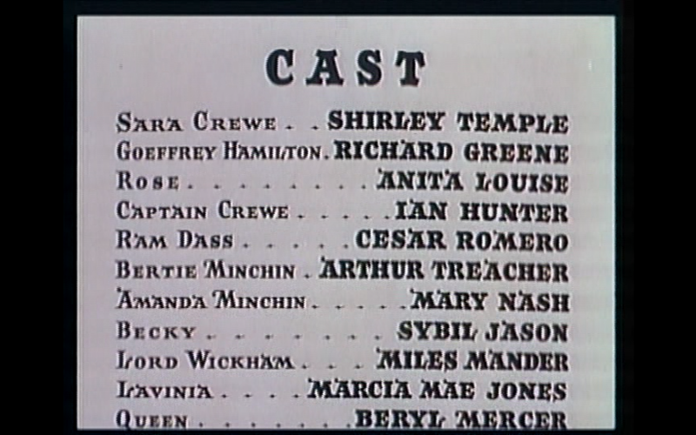
Temple: Preferred source
Title frames side 1

Slide 33
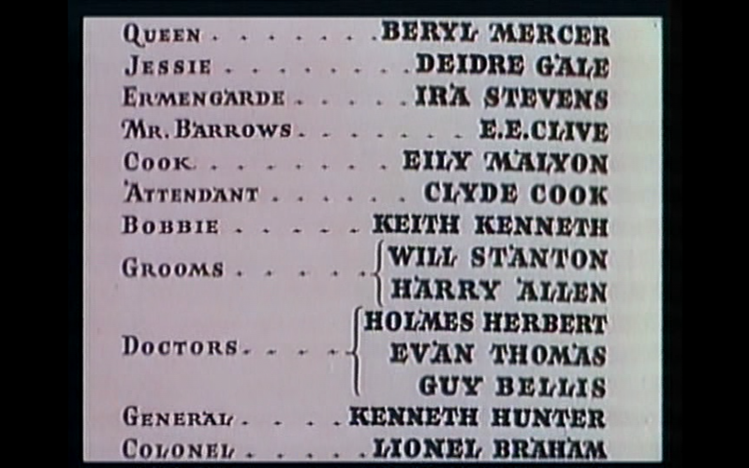
Temple: Preferred source
Title frames side 1

Slide 34

Temple: Preferred source
Title frames side 2 (collective title)

Slide 35
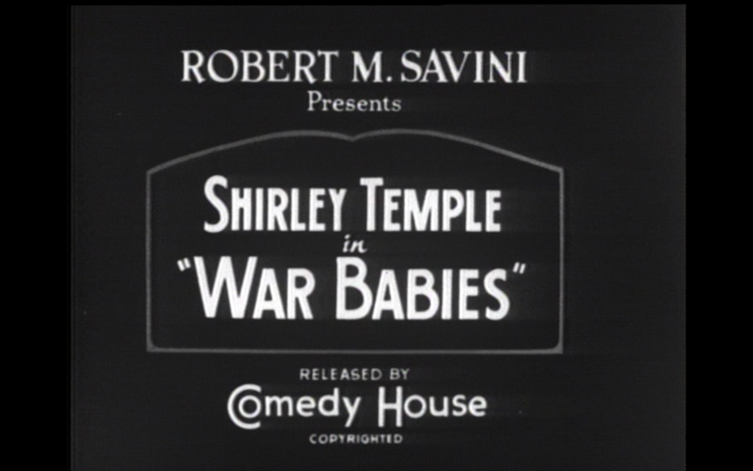
Temple: Preferred source
Title frames side 2 (film 1)

Slide 36

Temple: Preferred source
Title frames side 2 (film 2)

Slide 37
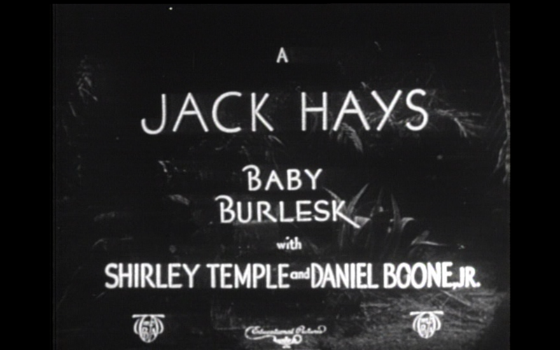
Temple: Preferred source
Title frames side 2 (film 2)

Slide 38
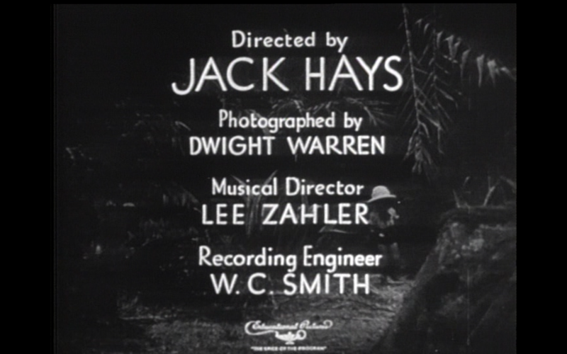
Temple: Preferred source
Title frames side 2 (film 2)

Slide 39
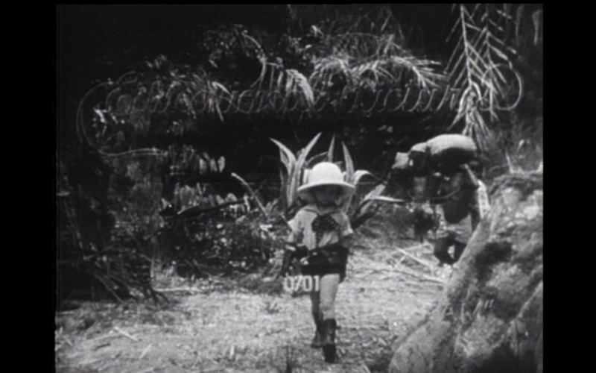
Temple: Preferred source
Title frames side 2 (film 2)

Slide 40
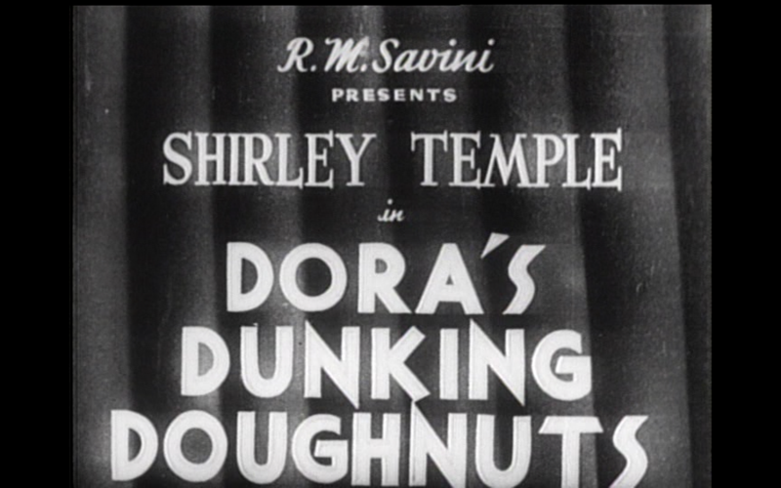
Temple: Preferred source
Title frames side 2 (film 3)

Slide 41
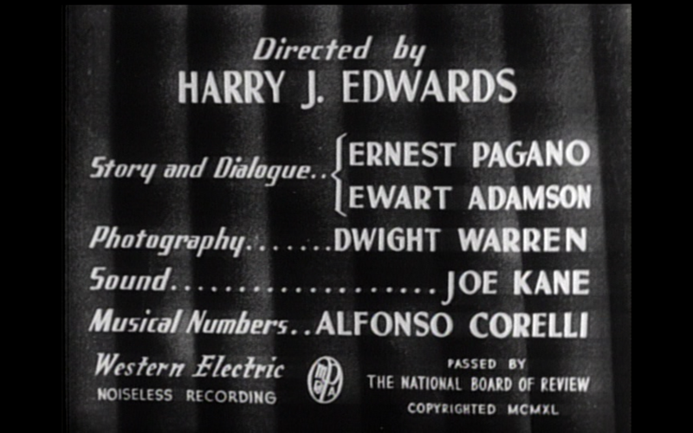
Temple: Preferred source
Title frames side 2 (film 3)

Slide 42
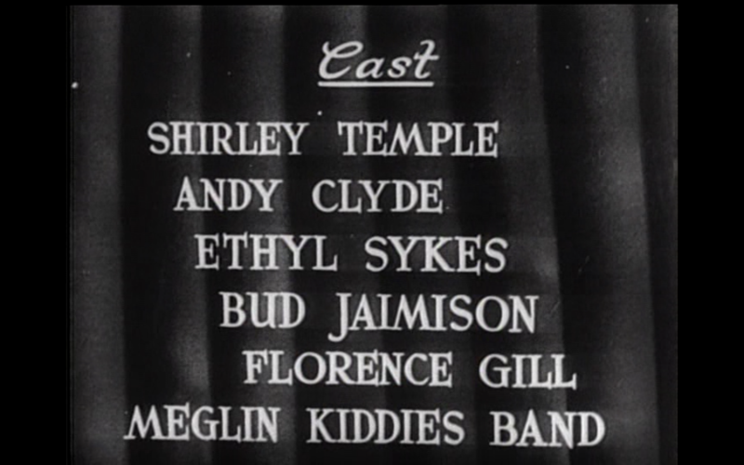
Temple: Preferred source
Title frames side 2 (film 3)

Slide 43

Temple: Preferred source
Title frames side 2 (film 4)

Slide 44
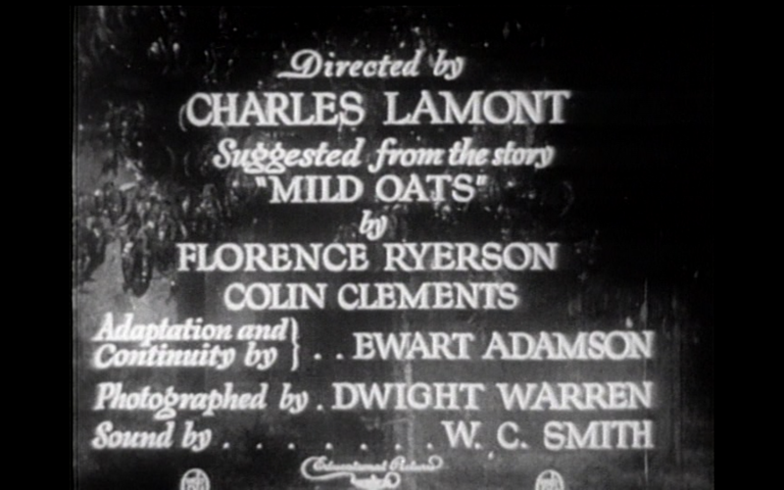
Temple: Preferred source
Title frames side 2 (film 4)

Slide 45
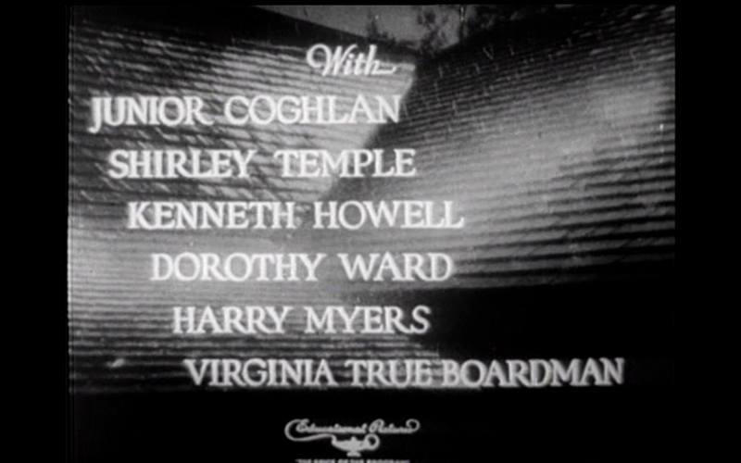
Temple: Preferred source
Title frames side 2 (film 4)

Slide 46
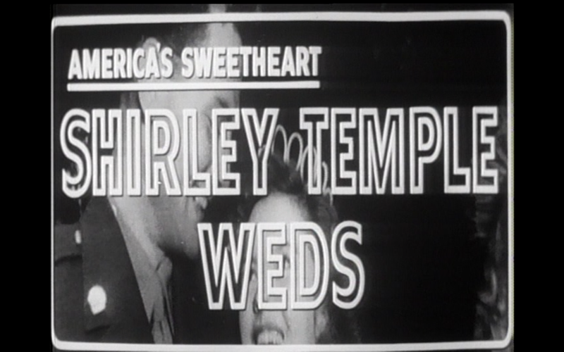
Temple: Preferred source
Title frames side 2 (film 5)

Slide 47


Temple:
Alternative preferred source

Slide 48


Temple: other source
Notes:
OK, now we have all our evidence out.

Slide 49
This Presentation is available at
http://net.lib.byu.edu/~catalog/people/rlm/RDAReno201302/index.htm
For further information
contact Robert L. Maxwell
robert_maxwell@byu.edu

